Slide 1
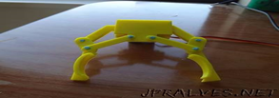
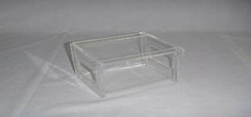
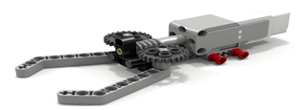
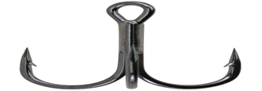
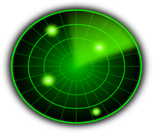
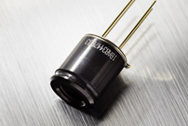
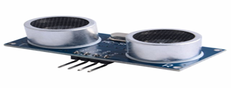
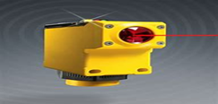

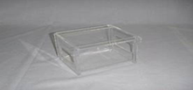
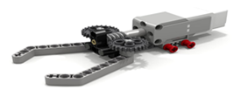
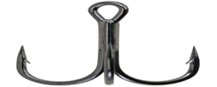

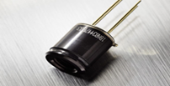

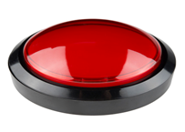
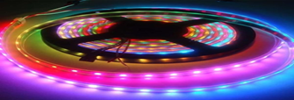
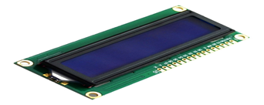


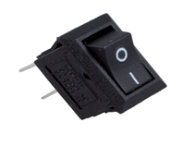
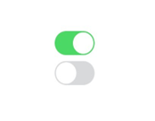
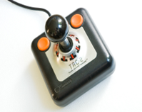
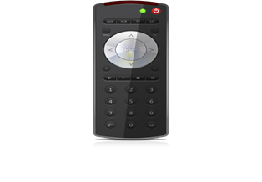
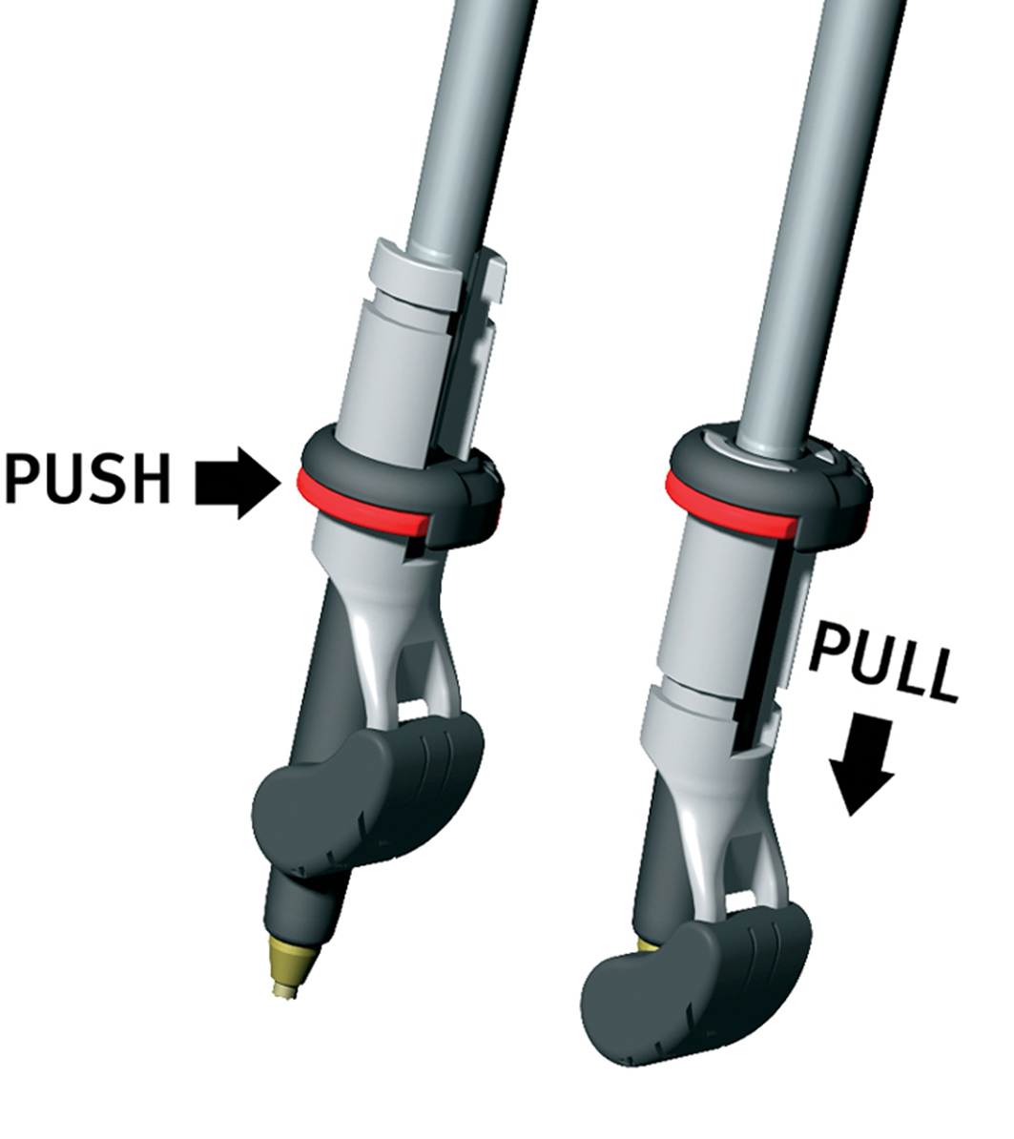
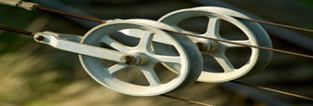
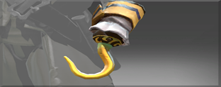
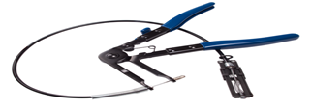

 | Functions | Mean 1 | Mean 2 | Mean 3 | Mean 4
1 | Hold the load | Claw | Container | Gripper | Hook
2 | Sense the load | Proximity | IR sensor | Ultrasonic sensor | Photoelectric sensor
3 | Carry the load | Claw | Container | Gripper | Hook
4 | Sense the destination | Proximity | IR sensor | Ultrasonic sensor | Photoelectric sensor
5 | Stop at the destination | Proximity | IR sensor | Ultrasonic sensor | Photoelectric sensor
6 | Indicate process completion | LED lights | Buzzer | LCD display | Voice message
7 | Detect the obstacles | Proximity | IR sensor | Ultrasonic sensor | Photoelectric sensor
8 | Machine ON\OFF | Buttons | App | Joystick | Remote
9 | Grip the rope | Wheel | Metal arm | Push\Pull | Clamper
10 | Move on the rope | Wheel | Metal arm | Push\Pull | Clamper

